Slide 1
Generative AI

Slide 2
Definitions
Foundation Model: A large AI model trained on a wide variety of data, which can do many tasks without much extra training.
Self-attention mechanism: The self-attention mechanism in a transformer is a process where each element in a sequence computes its representation by attending to and weighing the importance of all elements in the sequence, allowing the model to capture complex relationships and dependencies.
Textual Entailment: The relationship between text fragments where one fragment follows logically from the other.

Slide 3
Foundation vs. Traditional Models
Foundation Models | Traditional Models
Trained on vast, general datasets | Trained on smaller, task-specific datasets.
Designed to generalize across many tasks | Task-specific and domain-specific
Require immense computational resources | Less computationl resources required
Examples: GPT, Bard, LLaMa, BERT, DALL-E | Examples: linear regression, decision trees, CNNs, etc.

Slide 4
GLUE Tasks/Benchmarks
Short Name | Full Name | Description
CoLA | Corpus of Linguistic Acceptability | Measures the ability to determine if an English sentence is linguistically acceptable.
SST-2 | Stanford Sentiment Treebank | Consists of sentences from movie reviews and human annotations about their sentiment.
MRPC | Microsoft Research Paraphrase Corpus | Focuses on identifying whether two sentences are paraphrases of each other.
STS-B | Semantic Textual Similarity Benchmark | Involves determining how similar two sentences are in terms of semantic content.
QQP | Quora Question Pairs | Aims to identify whether two questions asked on Quora are semantically equivalent.

Slide 5
GLUE Tasks/Benchmarks
Short Name | Full Name | Description
MNLI | Multi-Genre Natural Language Inference | Consists of sentence pairs labeled for textual entailment across multiple genres of text.
QNLI | Question Natural Language Inference | Involves determining whether the content of a paragraph contains the answer to a question.
RTE | Recognizing Textual Entailment | Requires understanding whether one sentence entails another.
WNLI | Winograd Natural Language Inference | Tests a system's reading comprehension by having it determine the correct referent of a pronoun in a sentence, where understanding depends on contextual information provided by specific words or phrases.

Slide 6
SuperGLUE Tasks/Benchmarks
Short Name | Full Name | Description
BoolQ | Boolean Questions | Involves answering a yes/no question based on a short passage.
CB | CommitmentBank | Tests understanding of entailment and contradiction in a three-sentence format.
COPA | Choice of Plausible Alternatives | Measures causal reasoning by asking for the cause/effect of a given sentence.
MultiRC | Multi-Sentence Reading Comprehension | Involves answering questions about a paragraph where each question may have multiple correct answers.
ReCoRD | Reading Comprehension with Commonsense Reasoning | Requires selecting the correct named entity from a passage to fill in the blank of a question.

Slide 7
SuperGLUE Tasks/Benchmarks
Short Name | Full Name | Description
RTE | Recognizing Textual Entailment | Involves identifying whether a sentence entails, contradicts, or is neutral towards another sentence.
WiC | Words in Context | Tests understanding of word sense disambiguation in different contexts.
WSC | Winograd Schema Challenge | Focuses on resolving coreference resolution within a sentence, often requiring commonsense reasoning.
AX-b | Broad Coverage Diagnostic | A diagnostic set to evaluate model performance on a broad range of linguistic phenomena.
AX-g | Winogender Schema Diagnostics | Tests for the presence of gender bias in automated coreference resolution systems.

Slide 8
Biases in Training Data: Sources
Selection Bias: When the data used to train an AI model does not accurately represent the whole population or situation by virtue of the selection process, e.g., those choosing the data will tend to choose dataset their are aware of.
Historical Bias: Prejudices and societal inequalities of the past that are reflected in the data, influencing the AI in a way that perpetuates these outdated beliefs.
Confirmation Bias: The tendency to favor information that confirms pre-existing beliefs, which can affect what data is selected for AI training.

Slide 9
Biases in Training Data: Effects
Discriminatory Outcomes: Unfair results produced by AI that disadvantage certain groups, often due to biases in the training data or malicious actors.
Echo Chambers: Situations where biased AI reinforces and amplifies existing biases, leading to a narrow and distorted sphere of information.
Misrepresentation and Exclusion: model misrepresents or excludes certain groups.

Slide 10
Biases in Training Data: Mitigation
Organizational Diversity: Ensuring that the teams involved are diverse.
Diverse Data Collection: Actively seeking out diverse data sources.
Bias Detection and Correction: Processes and algorithms designed to identify and remove biases from data before it's used to train AI models.
Transparency and Accountability: Openness about how AI models are trained and the nature of their data, ensuring that developers are answerable for their AI's performance and impact.
Continuous Monitoring: Regularly testing and updating models.

Slide 11
Disinformation and Misinformation
Disinformation: Is a deliberate creation and dissemination of false information with the intent to deceive or mislead.
Misinformation: False information, however, without the intent to misinform though it may be due to carelessness or negligence.
Technical Terms:
Content Provenance Tools: Tools designed to track the origin and history of digital content. They help verify the authenticity of the content by providing information about its creation, modification, and distribution history.

Slide 12
Environmental and Human Impacts
Environmental:
High Energy Consumption: for training and inference.
Use of Non-Renewable Resources.
Electronic Waste.
Human:
Economic Disruption.
Bias and Fairness.
Privacy.
Misinformation and Disinformation.
Security.
Existential Threat to Humanity.

Slide 13
Adapting Foundation Models

Slide 14
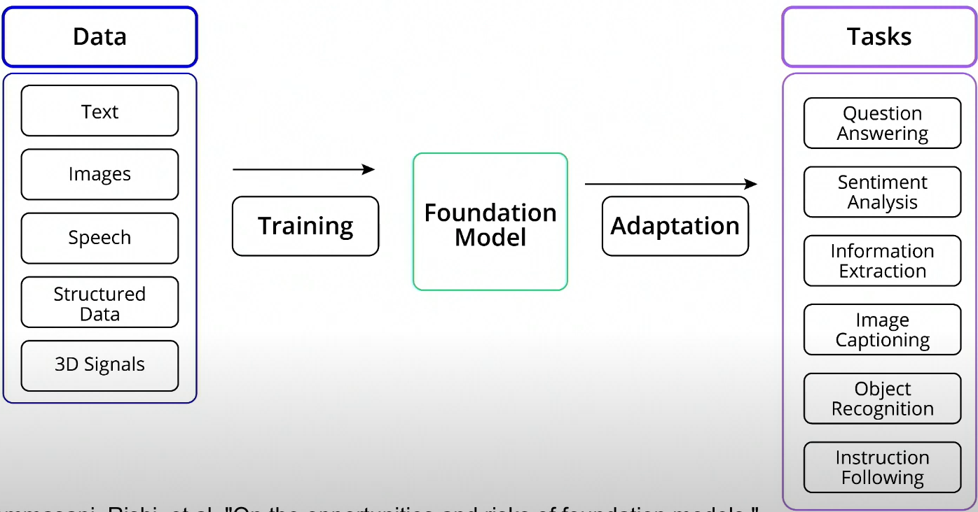
What is Adaptation?
Adaptation is the process of customizing foundation models to better suit specific applications or address up-to-date information.
Examples:
Chatbot adaptation for banking.
Structuring medical records.
General instruction-based adaptation, like translation.
Fine-tuning using private data.

Slide 15
Retrieval Augmented Generation (RAG)
Retrieval-Augmented Generation (RAG): is a powerful approach for keeping Generative AI models informed with the most recent data, particularly when dealing with domain-specific questions. It cleverly combines the comprehensive understanding capacity of a large language model (LLM) with the most up-to-date information pulled from a database of relevant text snippets. The beauty of this system is in its ability to ensure that responses remain accurate and reflective of the latest developments.

Slide 16
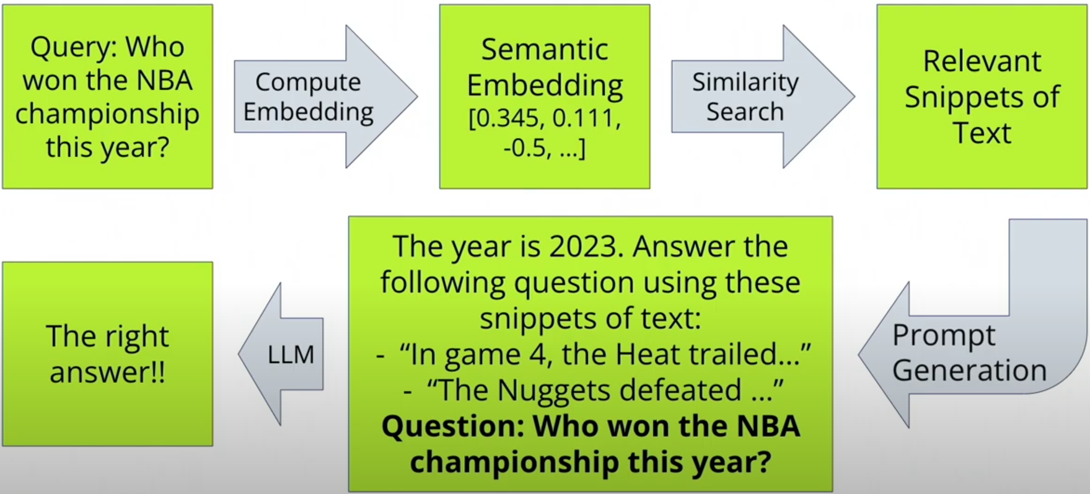
Retrieval Augmented Generation (RAG)

Slide 17
Retrieval Augmented Generation (RAG)
Technical Terms:
Semantic-embedding: A representation of text in a high-dimensional space where distances between points correspond to semantic similarity. Phrases with similar meanings are closer together.
Cosine similarity: A metric used to measure how similar two vectors are, typically used in the context of semantic embeddings to assess the similarity of meanings.
Vector databases: Specialized databases designed to store and handle vector data, often employed for facilitating fast and efficient similarity searches.

Slide 18
Prompt Design Techniques
Examples:
Prompt Tuning: Customizing templates or prompts to guide model predictions in a domain-specific task.
Few-shot Prompting: Providing a handful of examples to help guide the model’s predictions.
Zero-shot Prompting: Allowing the foundation model to handle tasks without any task-specific examples in the prompt.
Chain-of-Thoughts: Providing a series of logical reasoning steps within the prompt to boost the model’s ability to solve complex tasks.
In-context Learning: Allowing the models to learn from the context provided in the prompt by, for example, providing instructions or examples in the prompt.

Slide 19
Prompt Tuning
Technical Terms:
Prompt: In AI, a prompt is an input given to the model to generate a specific response or output.
Prompt Tuning: This is a method to improve AI models by optimizing prompts so that the model produces better results for specific tasks.
Hard Prompt: A manually created template used to guide an AI model's predictions. It requires human ingenuity to craft effective prompts.
Soft Prompt: A series of tokens or embeddings optimized through deep learning to help guide model predictions, without necessarily making sense to humans.

Slide 20
One and Few-Shot Prompting
One and few-shot prompting represent cutting-edge techniques that enable AI to adapt and perform tasks with minimal instructions. Instead of relying on extensive databases for learning, these methods guide generative AI through just one or a few examples, streamlining the learning process and demonstrating its ability to generalize solutions to new problems.
Technical Terms:
One-shot prompting: Giving an AI model a single example to learn from before it attempts a similar task.
Few-shot prompting: Providing an AI model with a small set of examples, such as five or fewer, from which it can learn to generalize and perform tasks.

Slide 21
Zero-Shot Prompting
Zero-shot prompting is a technique where a generative AI model can take on new tasks without the need for specific training examples. This process leverages the AI's extensive pre-existing knowledge gained from learning patterns across vast datasets.
Technical Terms:
Zero-shot prompting: This refers to the capability of an AI model to correctly respond to a prompt or question it hasn't explicitly been trained to answer, relying solely on its prior knowledge and training.

Slide 22
In-Context Learning
In-Context Learning: refers to the ability of LLMs to understand and perform a task given information in the prompt. It has two components:
Task Examples: Concrete examples of the tasks that the model can learn from, like a mini-labeled dataset.
Task Descriptions: More abstract and describe the task in words.

Slide 23
Chain-of-Thought Prompting
Chain-of-Thought Prompting: This is a vital technique for enhancing the reasoning capabilities of large language models by breaking down complex problems into intermediate steps that lead to a solution. By providing models with a line of reasoning, they can more effectively tackle problems that require more advanced problem-solving processes, enabling them to deduce information, such as the number of cookies in a box, after considering all variables.
Technical Terms:
Chain-of-Thought Prompting: A method of guiding a language model through a step-by-step reasoning process to help it solve complex tasks by explicitly detailing the logic needed to reach a conclusion.

Slide 24
Using Probing to Train a Classifier
Using probing to train a classifier is a powerful approach to tailor generative AI foundation models, like BERT, for specific applications. By adding a modestly-sized neural network, known as a classification head, to a foundation model, one can specialize in particular tasks such as sentiment analysis. This technique involves freezing the original model's parameters and only adjusting the classification head through training with labeled data.
Technical Terms:
Probing: This is a method of examining what information is contained in different parts of a machine learning model.
Linear Probing: A simple form of probing that involves attaching a linear classifier to a pre-trained model to adapt it to a new task without modifying the original model.
Classification Head: It is the part of a neural network that is tailored to classify input data into defined categories.

Slide 25
Fine-Tuning
Fine-tuning is an important phase in enhancing the abilities of generative AI models, making them adept at specific tasks. By introducing additional data to these powerful models, they can be tailored to meet particular requirements, which is invaluable in making AI more effective and efficient. It involves training all layers.
Technical Terms:
Fine-tuning: This is the process of adjusting a pre-trained model so it performs better on a new, similar task. It’s a type of Transfer-Learning.
Catastrophic Forgetting: This happens when a model learns something new but forgets what it learned before.

Slide 26
Fine-Tuning
Traditional Fine-Tuning Challenges:
Gathering labeled data, which is time-consuming and expensive.
Computational resources.
Storage, when performing multiple fine-tuning.
Out-of-distribution data. Fine-tuning can distort the internal representations when the foundation model is fine-tuned in data different from the original dataset on which the foundation model was trained (catastrophic forgetting).

Slide 27
Parameter-Efficient Fine-Tuning
Parameter-efficient fine-tuning (PEFT) is a technique crucial for adapting large language models more efficiently, with the bonus of not requiring heavy computational power. This approach includes various strategies to update only a small set of parameters, thereby maintaining a balance between model adaptability and resource consumption. The techniques ensure that models can be swiftly deployed in different industrial contexts, considering both time constraints and the necessity for scaling operations efficiently.

Slide 28
Parameter-Efficient Fine-Tuning
Technical Terms:
Parameter-efficient fine-tuning: A method of updating a predefined subset of a model's parameters to tailor it to specific tasks, without the need to modify the entire model, thus saving computational resources.
Low-Rank Adaptation (LoRA): A technique where a large matrix is approximated using two smaller matrices, greatly reducing the number of parameters that need to be trained during fine-tuning.
Adapters: Additional model components inserted at various layers; only the parameters of these adapters are trained, not of the entire model.

Slide 29
Large Language Models (LLMs) & Text Generation

Slide 30
Introduction to LLMs

Slide 31
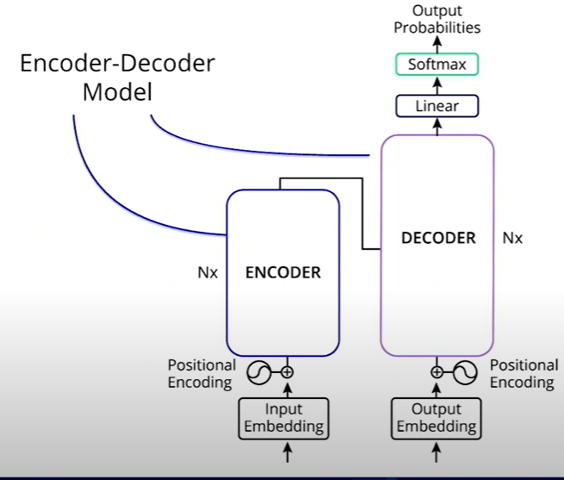
Encoder vs. Decoder Models
Example of Encoder-Decoder model is: Text-to-Text Transfer Transformer (T5).
Explanations of “Attention Is All You Need”: Illustrated Transformer and Annotated Transformer.

Slide 32
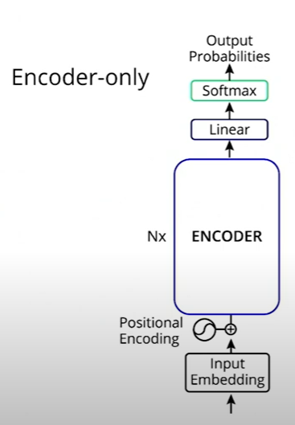
Encoder vs. Decoder Models
Example of Encoder-only models is: Bidirectional Encoder Representations from Transformers (BERT).

Slide 33
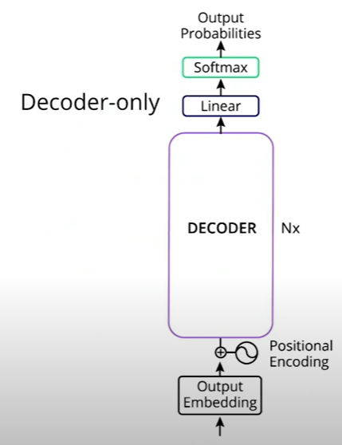
Encoder vs. Decoder Models
Example of Decoder-only models is: Generative Pre-Trained Transformer (GPT).
They use autoregressive language modeling objective during pre-training.

Slide 34
Completion vs. Instruction-following Models
Document completion.
Instruction following: base models have been tuned to follow instructions using a process called instruction fine-tuning or supervised fine-tuning (SFT). Applications include Q&A, text extraction, and text summarization. In SFT, a model must be trained on datasets composed of <instruction, response> pairs.
Instruction fine-tuning was broadly introduced in the InstructGPT model in the paper "Training language models to follow instructions with human feedback"(opens in a new tab) by OpenAI, with many more models to follow, as detailed in this survey paper on instruction tuning.

Slide 35
Enabling the Data Flywheel (InProgress)
An existing instruction fine-tuned model can be used in the creation of instruction training datasets.

Slide 36
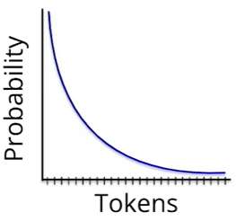
LLM Inference and Decoding Parameters
Decoding Parameters:
Rather than the single next token, an LLM’s output is a probability distribution across tokens. To choose the single next token to generate, a decoding mechanism must be specified.

Slide 37
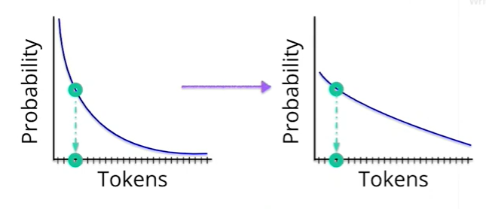
LLM Inference and Decoding Parameters
Many LLM inference APIs expose the same decoding parameters:
Temperature: increasing the temperature flattens the probability distribution, making it far more likely to sample a token that is not at the very top of the distribution. Increasing the likelihood of sampling from these less probable tokens can make the LLM response seem more creative.
Greedy decoding is an alternative to sampling, which always picks the most probable token; in this case, the actual probability distribution doesn’t matter. To use greedy decoding, set the temperature to zero.

Slide 38
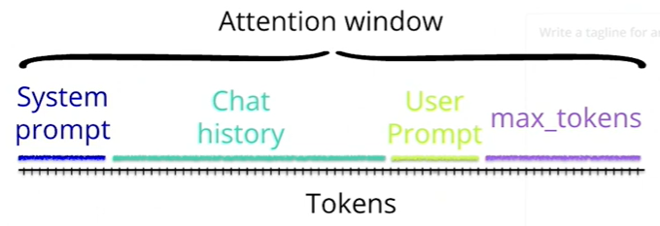
LLM Inference and Decoding Parameters
Decoding Parameters:
Maximum length (max tokens)

Slide 39
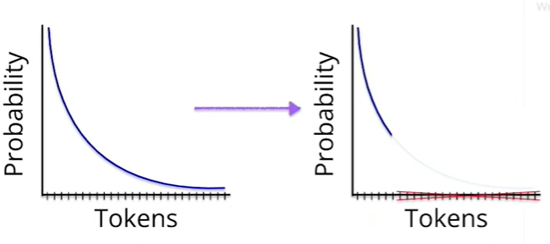
LLM Inference and Decoding Parameters
Decoding Parameters:
Top-P or Top-K: chops the probability distribution, excluding less probable tokens.

Slide 40
LLM Inference and Decoding Parameters
Decoding Parameters:
X-penalty, including repetition-penalty, frequency-penalty, and presence-penalty: they serve to reduce the likelihood of sampling specific tokens that have already appeared in the generated sequence, aimed towards reducing the likelihood of repeated sequences, a phenomenon that can particularly impact smaller models. Adjusting those values can impact greedy decoding if the most probable token is hit with a repetition penalty.
Resources:
Hugging Face blog.
OpenAI’s API and Together AI’s API.
The Curious of Neural Text Degeneration.

Slide 41
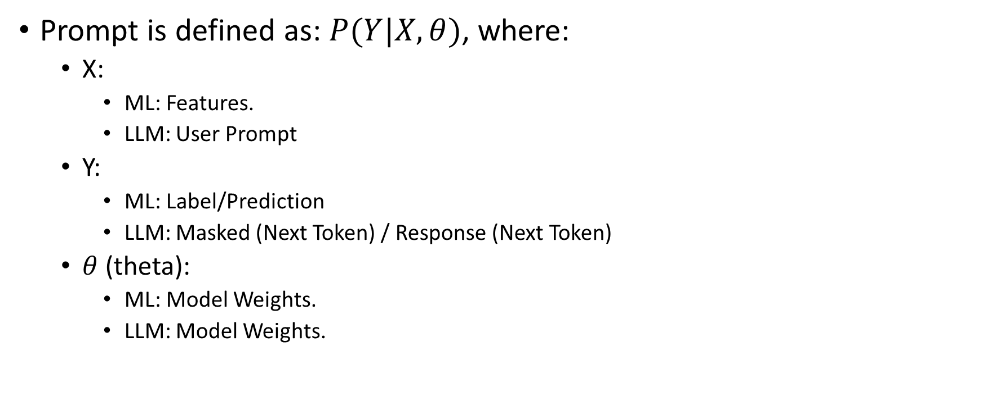
What Is a Prompt (InProgress)
Prompt is defined as: $P(Y|X, θ)$, where:
X:
ML: Features.
LLM: User Prompt
Y:
ML: Label/Prediction
LLM: Masked (Next Token) / Response (Next Token)
$θ$ (theta):
ML: Model Weights.
LLM: Model Weights.

Slide 42
What Is a Prompt
Example of virtuous Feedback Loop: Chain of thought prompting.
Example of vicious Feedback Loop: LLM-generated repetitions.

Slide 43
Chain of Thought Prompting (COT) (InProgress)
COT was first introduced in the paper "Large Language Models are Zero-Shot Reasoners"(opens in a new tab), and later simplified in a subsequent paper, "Chain-of-Thought Prompting Elicits Reasoning in Large Language Models"(opens in a new tab), and is still in use today. A variation of the COT method was used in Google's Gemini technical report.

Slide 44
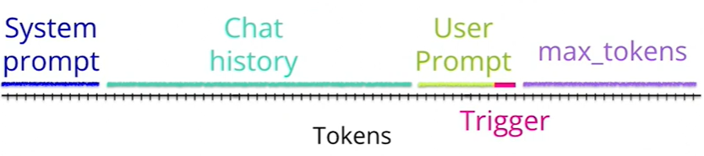
Anatomy of a Prompt

